Slide 1

SAP Build Process Automation
Day 1
Deloitte Consulting LLP
Notes:
A basic Operate/AMS presentation to take clients through our thoughts on operate.
Owner: TBD
Last Updated: 02/09/2018
Change log
V1.0
Color palette updated.
Fonts adjusted and resized.
Inverter test completed.
Cover image made transparent.
New text & Shape test passed.
Speaker notes reviewed and cleansed.

Slide 2
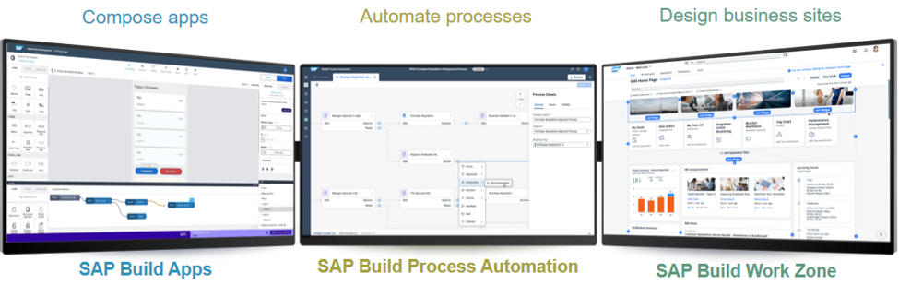
SAP Build Portfolio
SAP Build Apps
SAP Build Process Automation
SAP Build Work Zone
Build Visually
Collaborate effectively
Integrate smoothly
Automate complex applications
Drag and Drop simplicity tools
Source:
Note:

Slide 3
SAP Build Process Automation: Introduction
Core Strengths
Applications
Automate end-to-end cross-application workflows, that span several systems
No Code Interface
Automate manual, repetitive tasks such as copy-pasting data into a spreadsheet
Automate when there is a high volume of process steps
Develop Workflow Management
SAP Build Process Automation
Develop Robotic Process Automation
SAP Build Process Automation
Digitalize manual and semi-automated processes
Automatically aggregate data from multiple systems
AI Document Processing
Visually design Interface
Extend and adapt the standard flows of your business applications
Process Visibility

Slide 4
SAP Process Automation – Product Key Capabilities
Process
Advanced Workflow
Forms and Multi-Step Approvals
Business Rules and Decisions
Document Understanding
Unified Launchpad and Task Center
Process Visibility and Flexibility
Task Automation
Pre-build Content
The ability to create processes using visually drag and drop tools
Ability to use existing SAP Workflows from SAP Workflow Management
Information created or displayed using forms by users and approvers
Define flow of the process with policies and guidelines
Read data from documents using Machine Learning capabilities
One Inbox to handle all the tasks created by the process
Analytics on performance of the processes
Bot to perform automated tasks
Usable packages, templated automations, workflows, processes, process visibility, forms from SAP Store

Slide 5
Explore the SAP Build Process Automation Product
Build portfolio consists of 4 main components.
LOBBY Create, Manage and deploy business processes and action projects. Below are the types of project creation possible in Lobby section. Process Automation Business Application Studio Live Process Actions Build Apps - Web & Mobile Build Apps - Backend
STORE Consists of 480+ prebuilt content. SAP has provided 3 types of Projects (Process, Automation and Action) for which prebuilt content is available. Project setup guide and documentations are available which can also be leverages for customization. Filter criteria available in the terms of Project and format Type Content Type(Free/Paid) Catalog & Product Publisher Industry & Line of business
MONITOR Central Job Monitoring solution for all SAP products to complement local job scheduling. Creation of Triggers and managing the process visibility scenarios. Apps for monitoring are giving the details about Job status for processes and automations Connected agent’s information Event Acquisition application, you can view the events that have been acquired by process visibility capability Contains job history and highly executed job information quota consumption
SETTINGS This is the collection of Tenant, agent and alert configuration, mail, Cloud ALM and API connectivity setup, security credentials store. Agent setup is the prerequisite for Build automation setup. The mass agent registration feature in settings allows to register a great number of agents on a specific agent group. External system’s IP whitelisting and authentication setup feature is also available here.

Slide 6
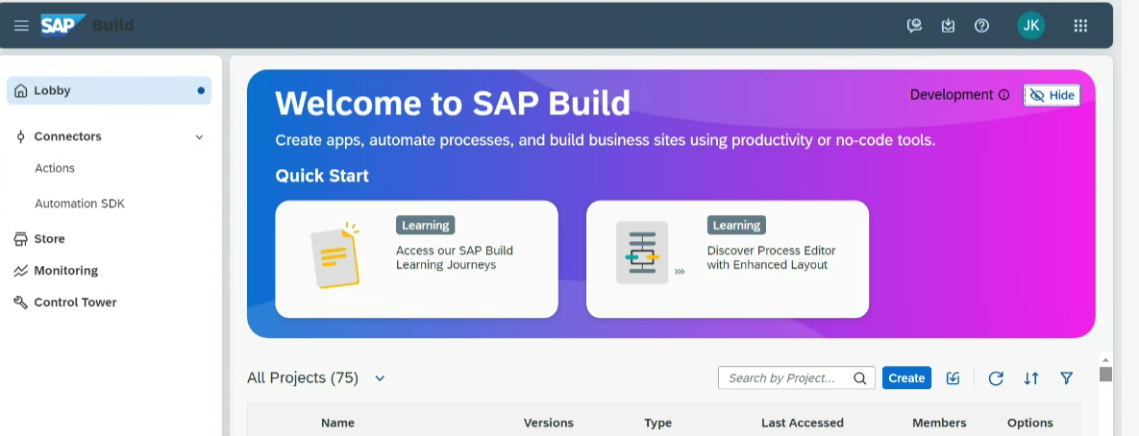
Explore the SAP Build Process Automation Product
Lobby: Create, Manage and deploy business processes and action projects.

Slide 7
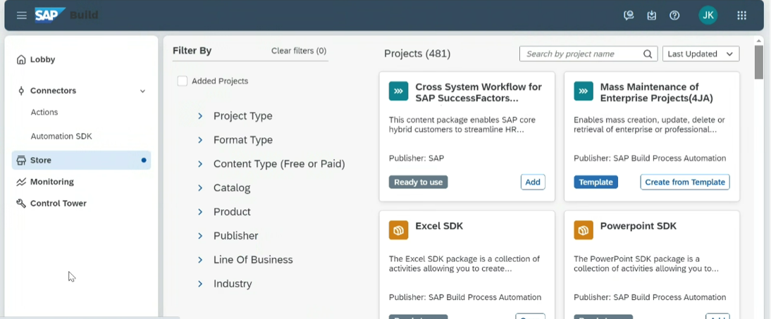
Explore the SAP Build Process Automation Product
Store : Live Projects, Templates from SAP

Slide 8
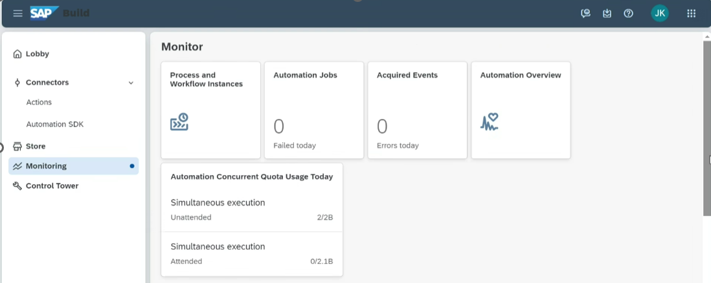
Explore the SAP Build Process Automation Product
Monitor : Monitor and Evaluate Business Process Automations

Slide 9
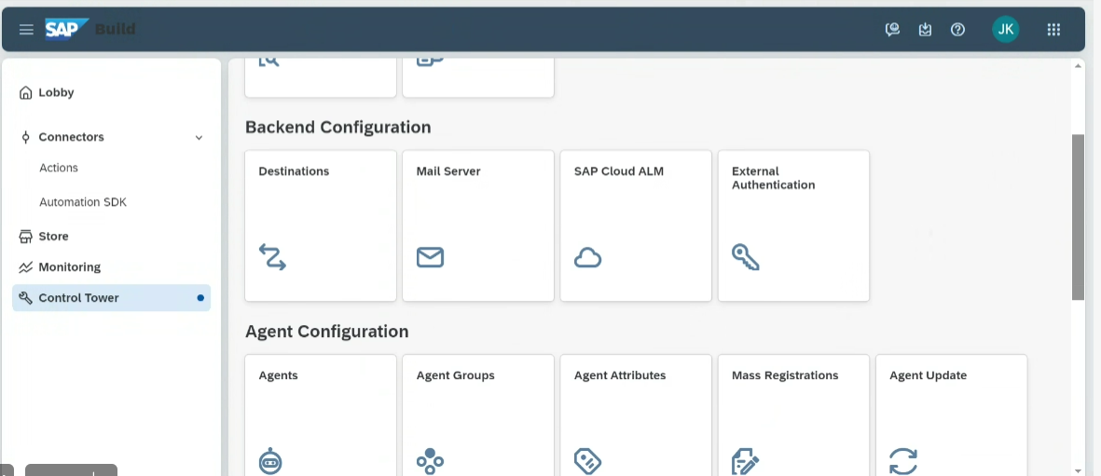
Explore the SAP Build Process Automation Product
Control Tower : Setup an agent, variables and connections.

Slide 10
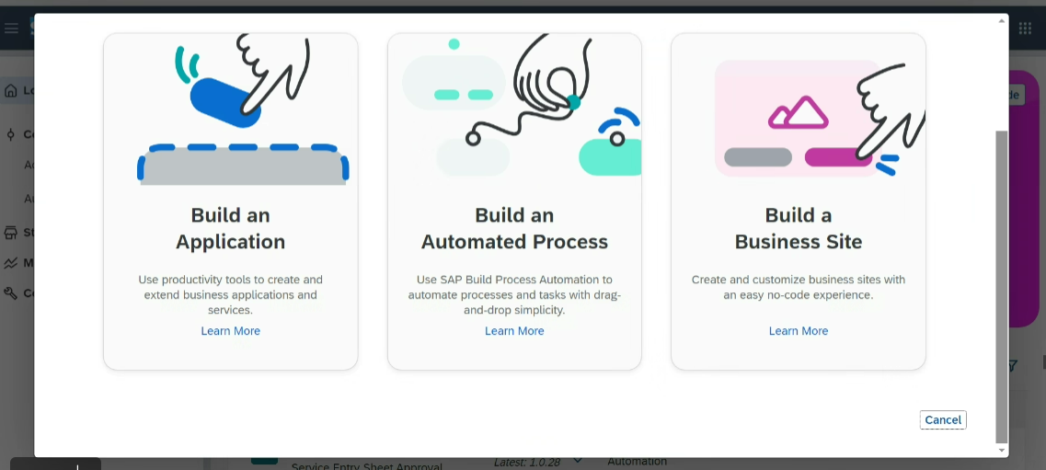
Build Process Automation Creation
From Lobby, different options available to create below types of artifacts

Slide 11
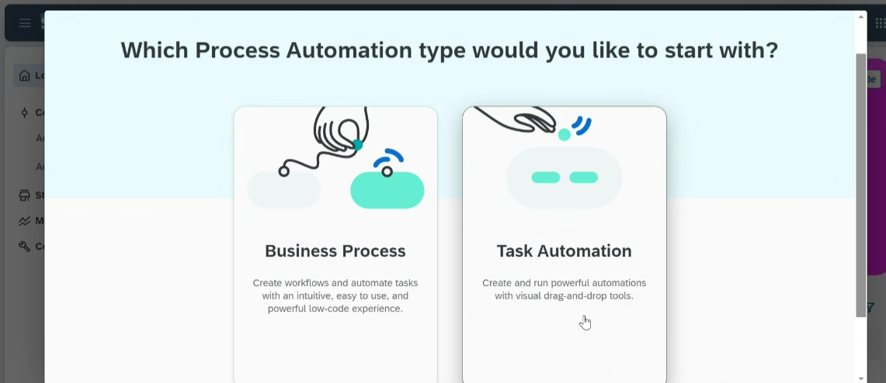
Build Process Automation Creation
Below types of process automation available

Slide 12
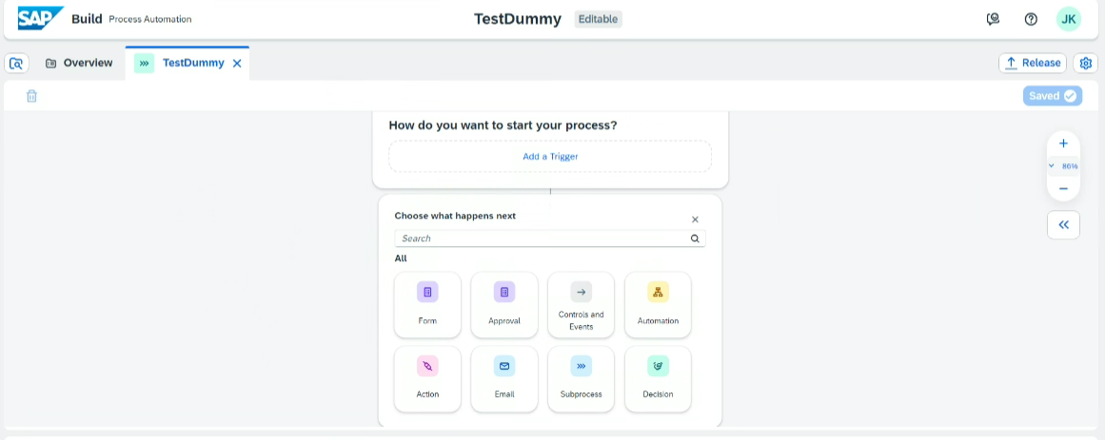
Build Process Automation Creation
SAP Build Process Automation combines workflow management, RPA functionality, decision management, process visibility, and embedded AI capabilities into one intuitive low-code experience.

Slide 13
SAP Workflow Evolution

Slide 14
BTP Cloud Workflow(Workflow Management Service/BPA)
SAP ECC Workflow/Flexible Workflow
Used to develop on Premise Solution Complex context format since it is in container format. Standard My Inbox Fiori App with fixed Layout. Complex Framework to develop workflow. Additional configuration required for Emails, notifications. No inbuilt framework available to generate run time report for workflows.
Used to develop global Cloud Solution. Simple context format since it is in JSON format. One can design Custom UI for My Inbox. Easy drag and drop framework. Very easy to integrate and achieve Email functionality. Process Visibility Feature for deriving real time analytical report for workflows.

Slide 15
Thank You!!

